Slide 1
Histology
Katie Garen

Slide 2
Cardiac Muscle

Slide 3
Compact Bone

Slide 4
Elastic Cartilage

Slide 5
Simple Squamous Epithelium (top view)

Slide 6
Blood

Slide 7
Smooth Muscle

Slide 8
Transitional Epithelium

Slide 9
Simple Cuboidal Epithelium

Slide 10
Skeletal Muscle

Slide 11
Fibrocartilage

Slide 12
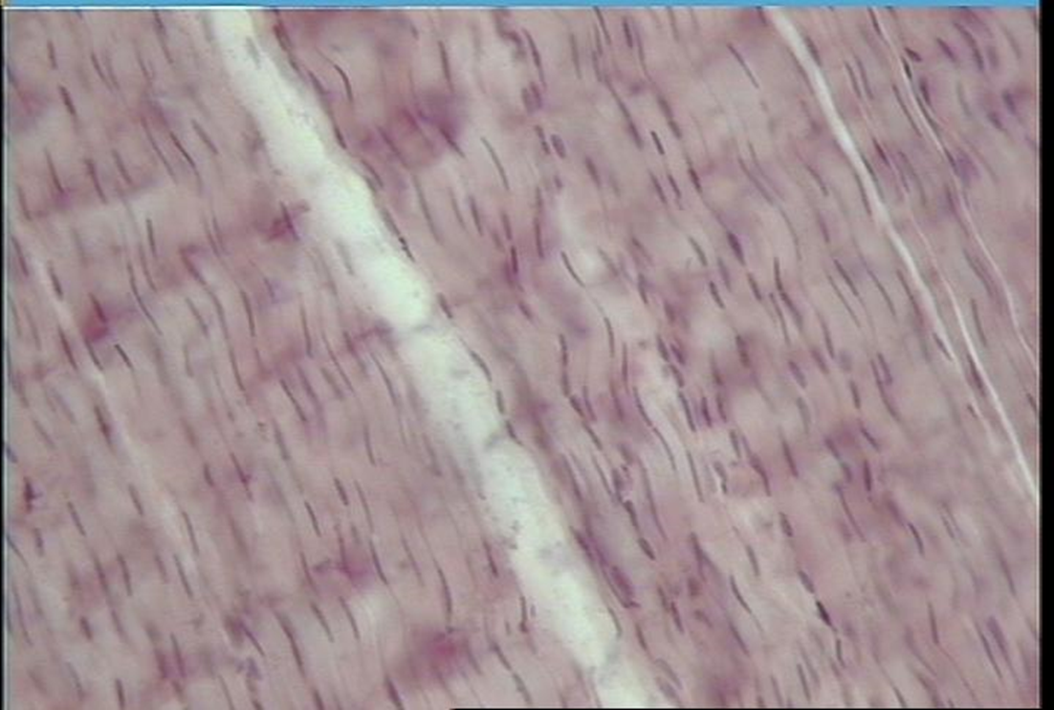
Dense Regular Connective Tissue (Longitudinal Section)

Slide 13
Stratified Squamous Epithelium

Slide 14
Hyaline Cartilage

Slide 15
Adipose Tissue

Slide 16
Simple Squamous Epithelium (cross section)

Slide 17
Dense Irregular Connective Tissue

Slide 18
Nerve Tissue

Slide 19
Dense Regular Connective Tissue (cross section)

Slide 20
Simple Columnar Epithelium

Slide 21
Compact Bone (c.s.)

Slide 22
Loose Connective Tissue (Aerolar Tissue)

Slide 23
Pseudostratified Columnar Epithelium

